Slide 1

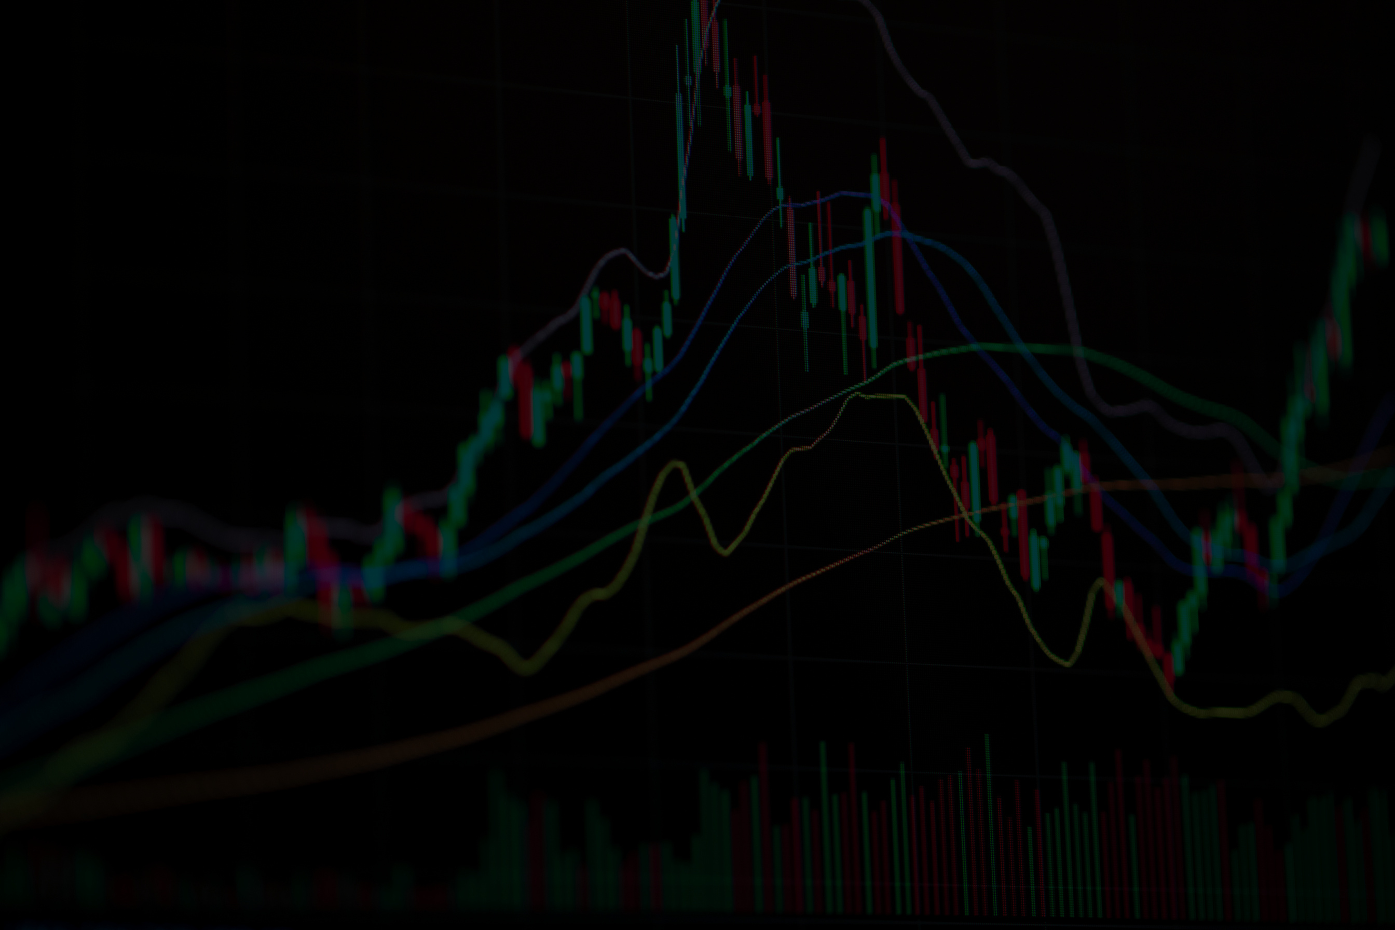

SENTIMENT-DRIVEN STOCK ANALYSIS: PREDICTING NVIDIA’S MARKET RETURNS USING MULTIMODAL DATA
Bryan & Harsha

Slide 2
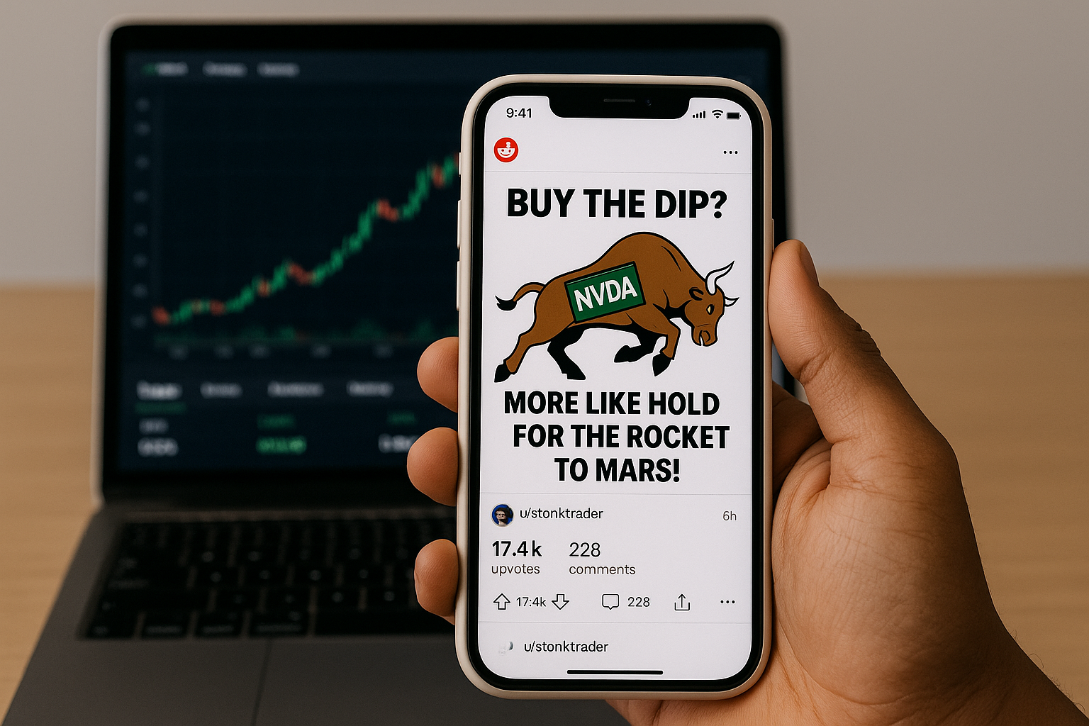

What are the
Key Objectives?
Predict NVIDIA (NVDA) stock price movements by analyzing social media (r/Wallstreetbets) sentiment
Blend textual sentiment with structured financial data
Explore the correlation between public sentiment shifts and volatility

Slide 3
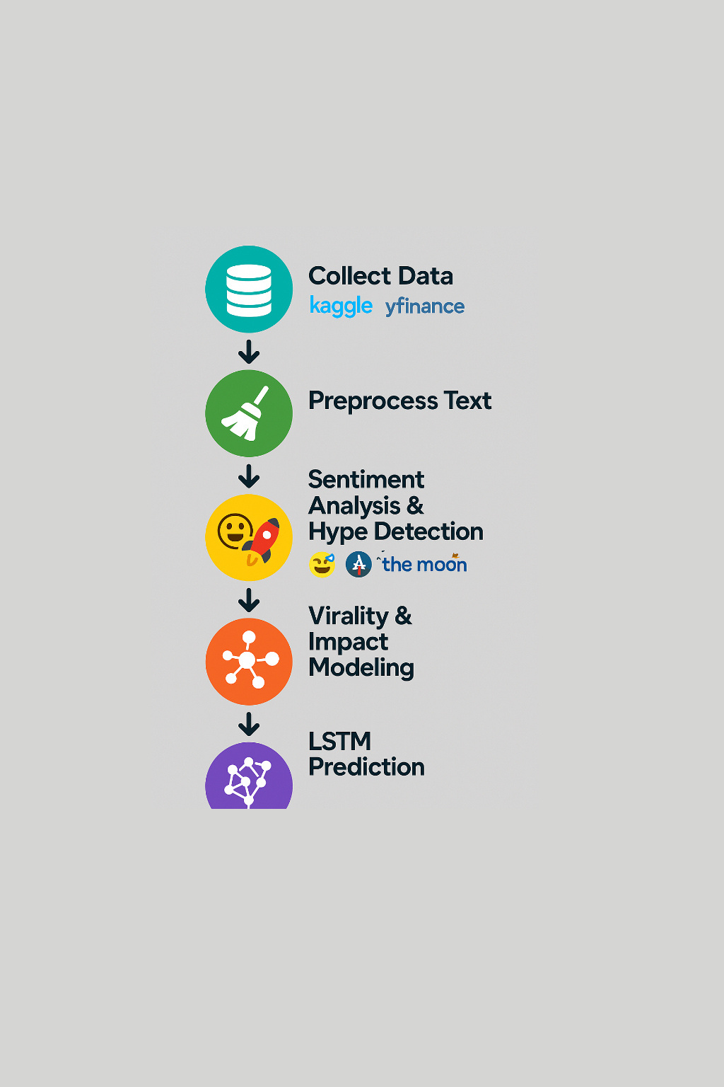
Methodology
Collect data (Kaggle and yfinance)
Preprocess the text (cleaning, emoji, filtering )
Apply sentiment analysis and detected emoji/’hype’ terms (e.g., 🚀, “to the moon”).
Virality and impact modeling
Next day price prediction modeling using LSTM

Slide 4
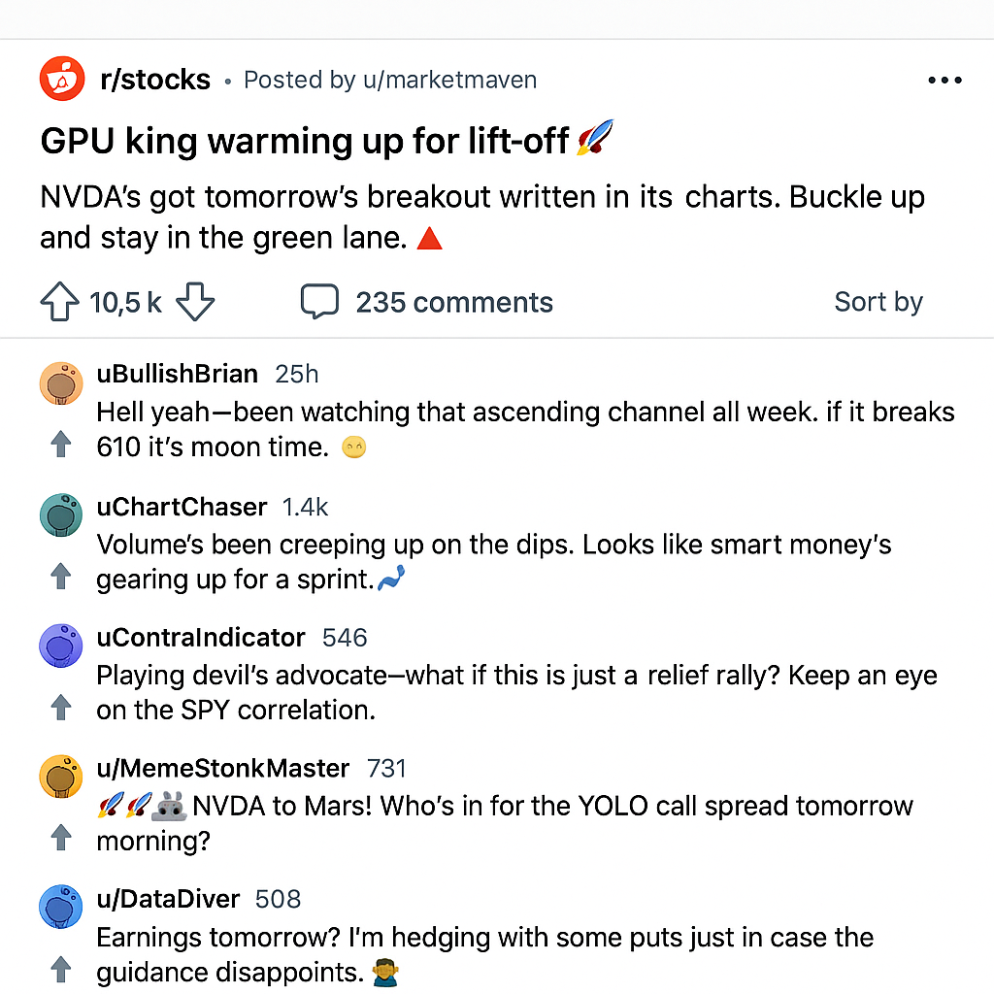

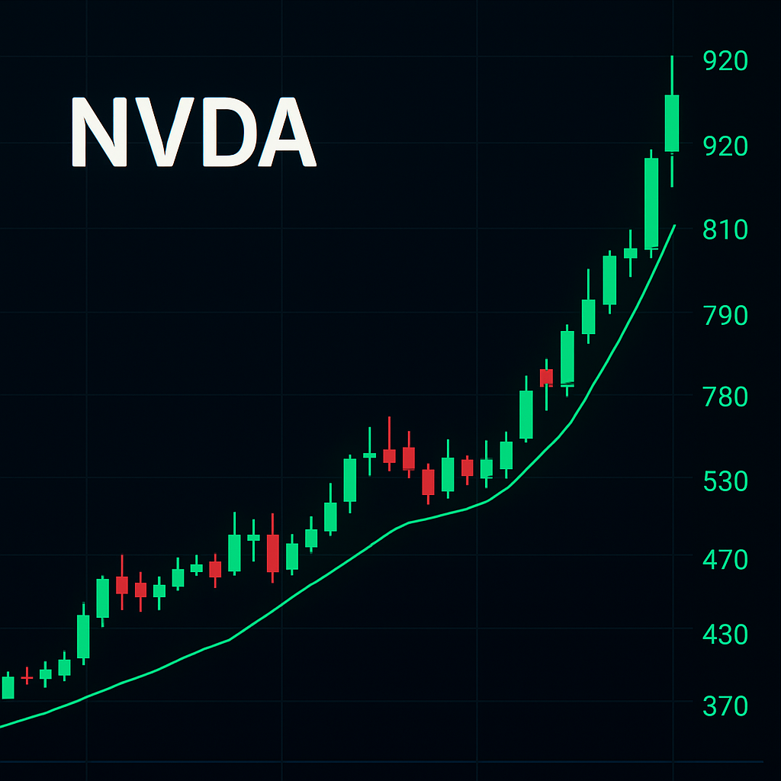
Key Findings
Sentiment Trends
Early Sentiment Signals
Sentiment analysis captured major volatility peaks such as the DeepSeek crisis and AI sector rallies.
Reddit and Twitter sentiment shifted sharply before technical indicators like MACD or RSI signaled any trend changes.
Temporal Advantage
Retail sentiment led stock price movements by 18 to 42 hours across platforms.
Meme-driven sentiment surges amplified market reactions, proving that sentiment-based insights can forecast short-term stock price dynamics more effectively than traditional methods.

Slide 5




Reddit WallStreetBets:
Posts from 2021-2025 via Kaggle (combined dataset)
Data Sources
Financial Data:
Yahoo Finance (yfinance)
VIX Volatility Index

Slide 6
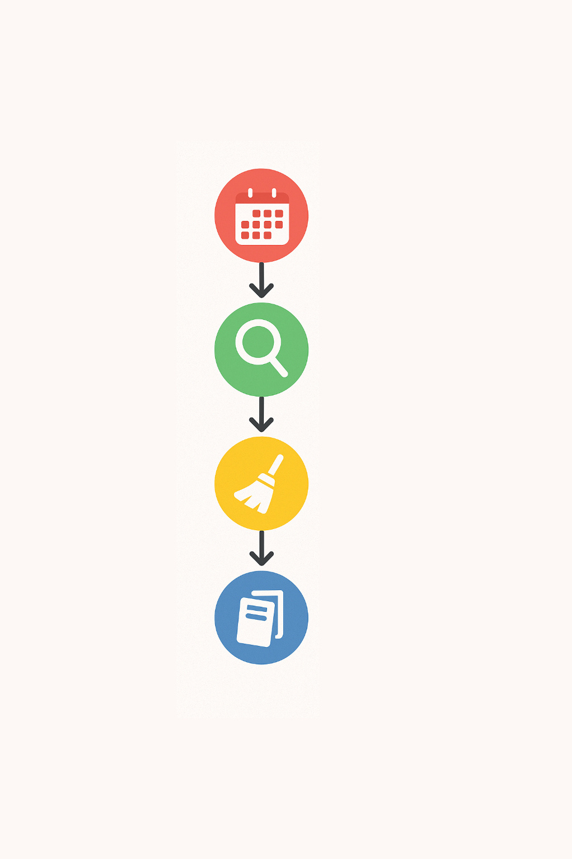

Combined multi-year r/WallStreetBets datasets
Data Preprocessing
Filter posts with ticker mentions (NVDA)
To ensure high-quality sentiment inputs, we first aggregated multi-year Reddit datasets focused on finance discussions.
Rigorous cleaning steps were applied to correct formatting errors, standardize timestamps, and remove duplicate entries, resulting in a robust dataset ready for sentiment scoring and modeling.
Clean and fix columns
Remove duplicates

Slide 7
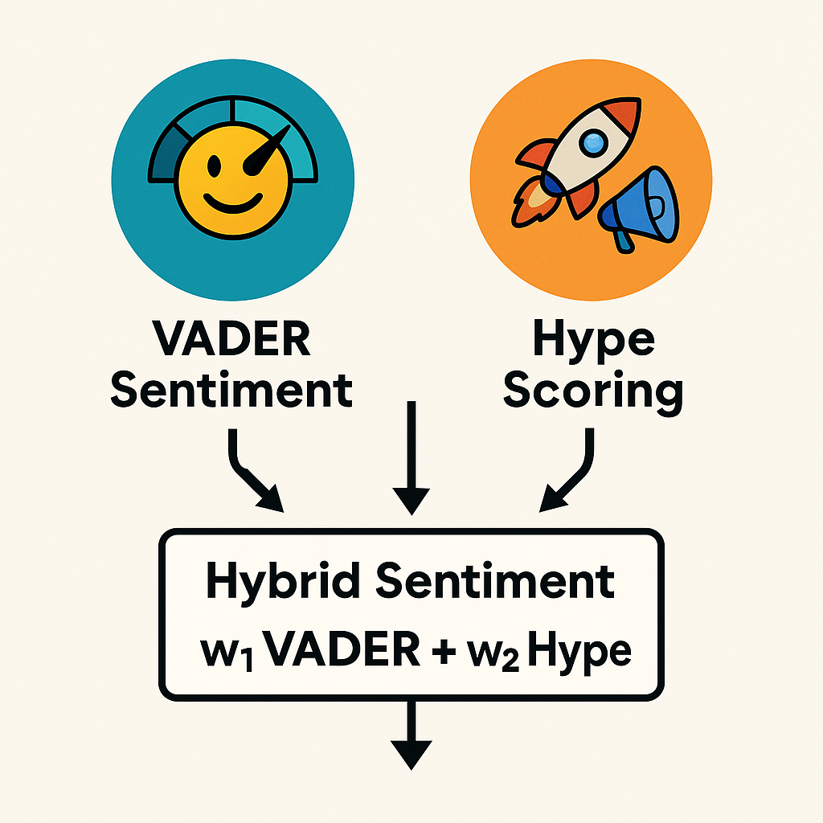
Model
Sentiment Analysis
Tools:
VADER for sentiment scores
Counting the custom “hype” scoring for the emojis and phrases
Key steps:
Weighted combination of our VADER sentiment and hype detection gives us our hybrid sentiment

Slide 8
Virality and Impact Scoring
Definition
Mechanism
Why It Matters
Virality captures popularity = Upvotes + Comments
Impact = Hybrid Sentiment × Virality
Posts with high engagement (upvotes, comments) have more influence
Impact score scales sentiment by actual social attention
Measures not just what people say
Also measures how much people care
Prioritizes emotionally charged viral posts

Slide 9













Agenda
Collect Features
Mean/Sum of Sentiment, Hype, Impact (daily)
Train LSTM Model
80/20 Split
70 Epochs Training
Rolling Window Update
Update Features Every 5 Days
Merge with Stock Data
Combine with NVDA OHLCV + VIX Index (yfinance)
Predict Next-Day Returns
Output stock return prediction

Slide 10
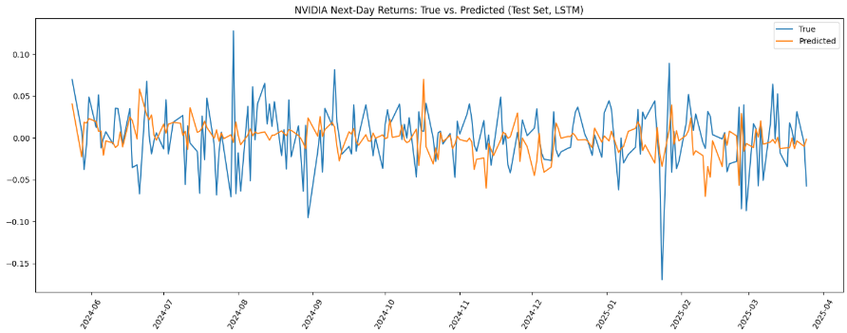
Our LSTM captures general trends but struggles with sharp volatility spikes.
While test RMSE is low (0.0401), limited R² highlights the unpredictability of daily returns.
High-confidence sentiment signals still offer strong trading opportunities.

Slide 11


Strengths and Limitations
Strengths (+)
Limitations (-)
Low prediction error (RMSE = 0.0401) — model tracks true NVDA moves reliably
Real-time adaptable scraping and prediction framework
Impact-weighted sentiment scoring (upvotes + comments)
Negative R² reflects difficulty in consistently outsmarting market randomness
No sarcasm detection (future enhancement)
Market noise and low volatility reduced prediction sharpness
Focused only on NVIDIA; model not tested on multiple tickers

Slide 12
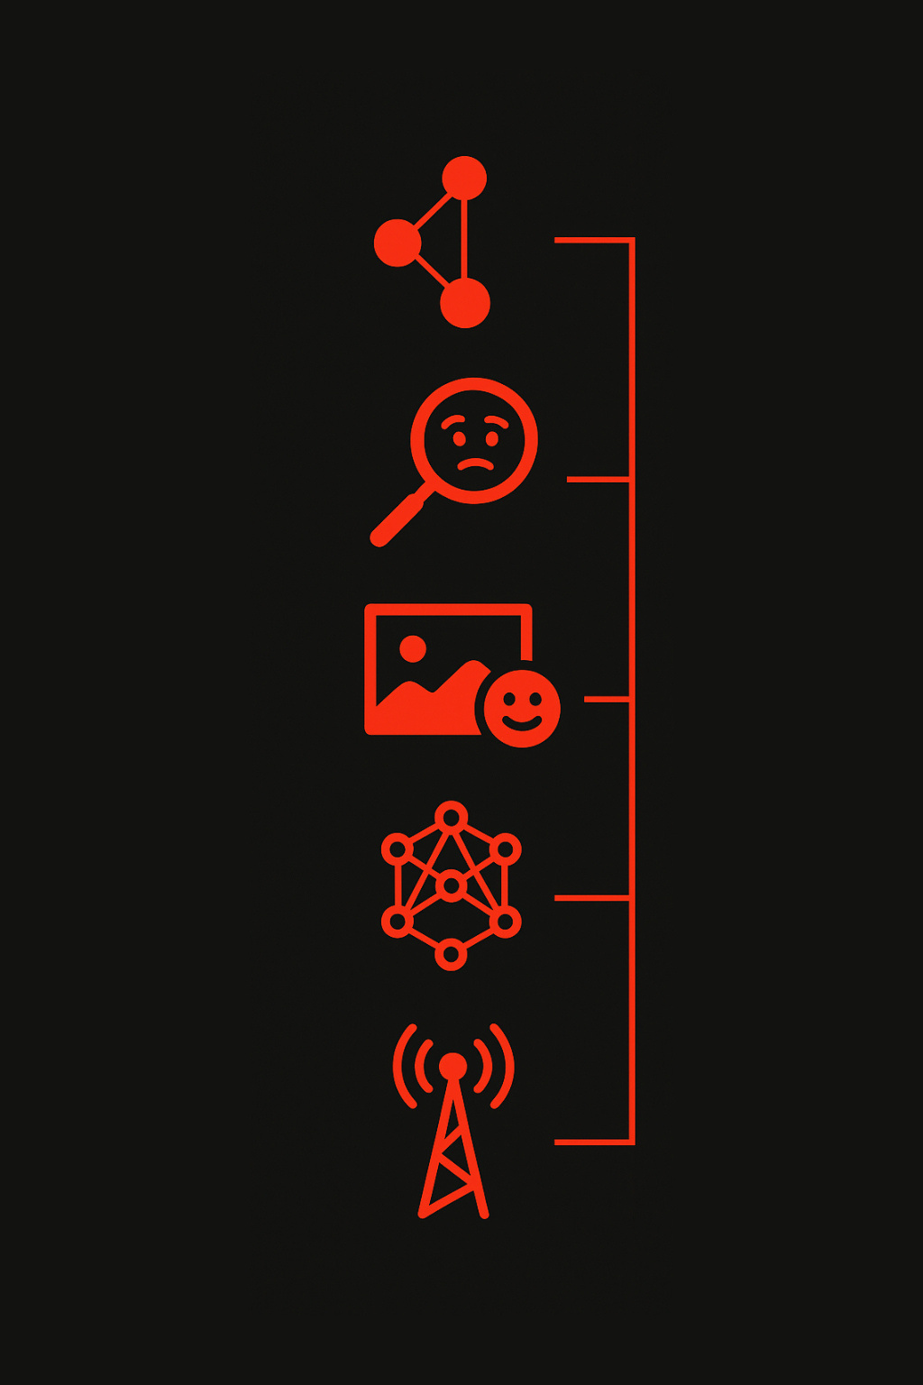
Expand Sentiment Sources
Ideas for Future Research
Integrate Twitter, TikTok, YouTube, and multi-news platforms
Detect Sarcasm & Negation
As social media sentiment analysis continues to evolve, future research can expand beyond Reddit and financial news alone.
Enhancements such as sarcasm and negation detection, computer vision for meme sentiment, and dynamic deep learning architectures will significantly boost forecast accuracy.
Real-time integration of these systems could enable live trading signals based on emerging sentiment trends.
Build advanced models to catch ironic or negated sentiment
Enhance Image Sentiment
Apply Vision Transformers (ViT) for meme and visual context understanding
Deep Learning Upgrades
Explore sophisticated LSTM, GRU, Transformer architectures
Real-Time System Integration
Deploy live sentiment analysis pipelines for instant decision making

Slide 13

Conclusion
Even though we could not successfully predict market volatility, we believe this research can open up areas of market predictions algorithms using sentiment analysis and offers real value for understanding, explaining and monitoring modern crowd-driven market
Regardless of our results we learned:
That returns are driven by randomness and rare occurring events that shift the market, making them hard to forecast.
How to implement sentiment modeling, emoji extraction, impact quantification and more.
Creating meaningful features to enhance performance

Slide 14
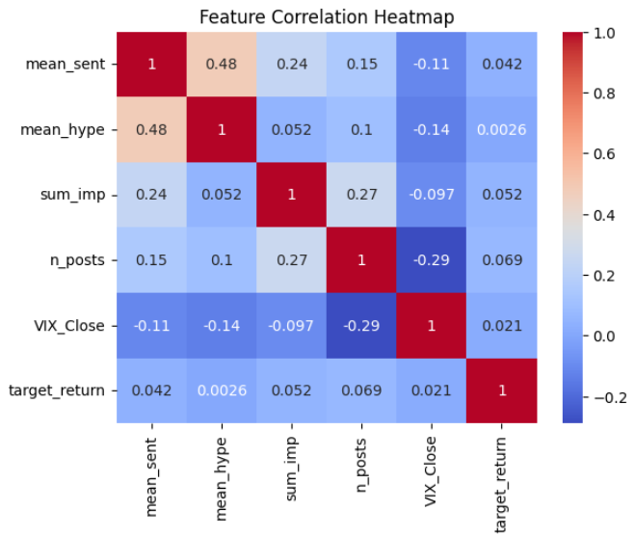

Slide 15
THANK
YOU.

